Slide 1
Uber Ride Analytics Dashboard
Presented by:
Farzana p a

Slide 2
INTRODUCTION
The ride-hailing industry generates a large amount of real-time data such as bookings, cancellations, payments, and customer feedback.
Analyzing this data manually is difficult and time-consuming.
Power BI helps transform raw ride data into meaningful insights through interactive visualizations.
This project focuses on analyzing Uber ride performance using a dynamic dashboard.

Slide 3
PROJECT OBJECTIVES
To analyze overall ride performance
To evaluate total revenue and ride volume
To identify peak booking hours
To analyze cancellation patterns
To understand customer ratings
To build an interactive and user-friendly dashboard
To support better decision-making

Slide 4
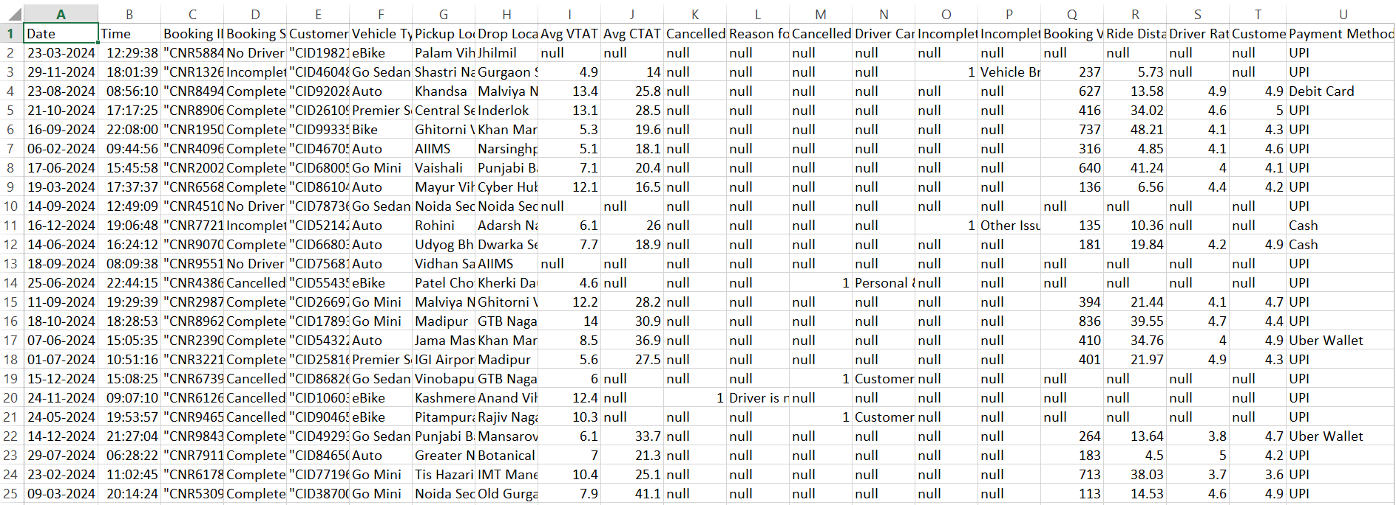
DATASET

Slide 5
DATASET DESCRIPTION
The dataset used in this project contains ride-related information.
Key attributes include:
Booking ID
Booking Status (Success, Cancelled, Failed, Incomplete)
Booking Value (Revenue)
Ride Distance
Customer Rating
Payment Method
Vehicle Type
Date and Time
This dataset helps analyze operational and financial performance.

Slide 6
TOOLS & TECHNOLOGIES
Power BI – Data visualization and dashboard creation
Excel / CSV Dataset – Data source
Data Cleaning & Transformation – Power Query
DAX (Data Analysis Expressions) – Calculations and measures
Power BI is used to convert raw data into interactive dashboards.

Slide 7
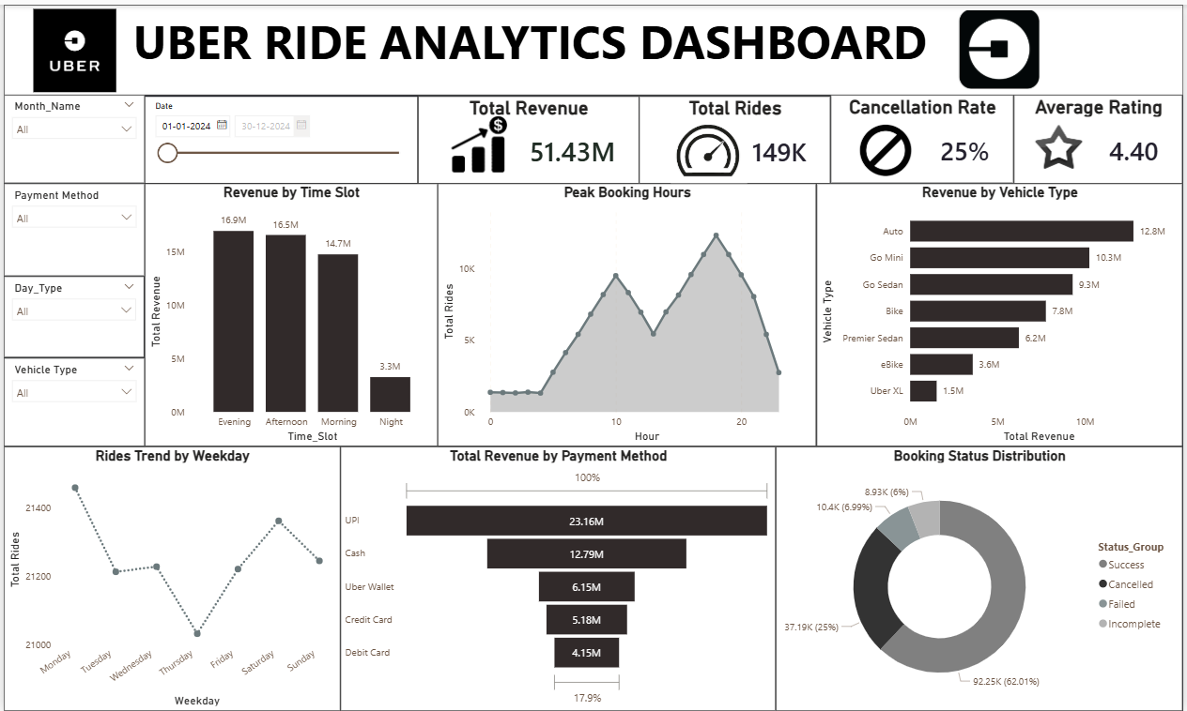
DASHBOARD

Slide 8
DASHBOARD OVERVIEW
The Uber Ride Dashboard provides a complete overview of ride performance.
It includes:
KPI metrics
Charts and graphs
Interactive filters
Trend analysis
The dashboard is designed to be visually appealing, simple, and interactive.

Slide 9
KPI METRICS
The dashboard displays key performance indicators:
Total Revenue – Total earnings from rides
Total Rides – Number of bookings
Cancellation Rate – Percentage of cancelled rides
Average Rating – Customer satisfaction score
These KPIs provide a quick summary of system performance.

Slide 10
VISUALIZATIONS USED
Different types of charts are used in the dashboard for better data representation:
Clustered Column Chart – Used to compare revenue across different time slots
Area Chart – Used to visualize peak booking hours and ride trends over time
Stacked Bar Chart – Used to compare revenue contribution by vehicle types
Line Chart – Used to analyze ride trends by weekday
Funnel Chart – Used to represent revenue distribution by payment methods
Donut Chart – Used to show booking status distribution (Success, Cancelled, etc.)
These visualizations help in understanding patterns, comparisons, and trends effectively.

Slide 11
FILTERS (INTERACTIVITY)
Filters are used to make the dashboard interactive.
Filters included:
Month
Date Range
Payment Method
Vehicle Type
Day Type
Users can dynamically explore data based on their selection.

Slide 12
KEY INSIGHTS
From the dashboard, we can observe:
Evening time generates higher revenue
Peak booking hours occur during specific time ranges
UPI is the most used payment method
Some vehicle types contribute more revenue
A portion of rides gets cancelled
These insights help improve operational efficiency.

Slide 13
CONCLUSION
The Uber Ride Analytics Dashboard effectively transforms raw data into meaningful insights.
It helps in:
Monitoring ride performance
Understanding customer behavior
Identifying trends and patterns
Supporting data-driven decision-making
Power BI provides an efficient platform for data visualization.

Slide 14
SUGGESTIONS
Reduce ride cancellations through better driver allocation
Focus on peak hours for pricing optimization
Improve customer experience to increase ratings
Promote high-performing vehicle categories
Encourage digital payments like UPI

Slide 15
THANK YOU

